Slide 1

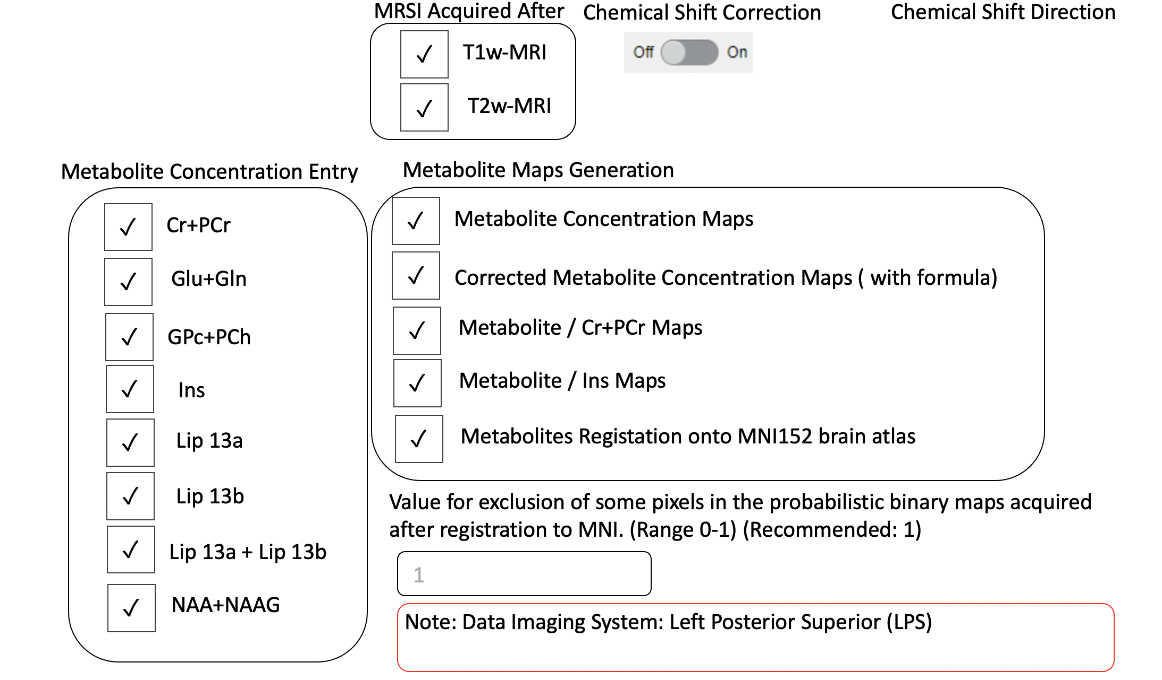

RF Bandwidth of your system
Cut-Off Values for Exclusion Critetia
RF_ex_bw:
RF_echo_bw:
RF_echo2_bw:
Default: 4253
fcsf:
CRLB:
SNR:
FWHM:
>0.30 (Default)
Default: 1269
> 30 (Default)
Default: 1269
< 8 (Default)
> 0.10 (Default)
Note:
Gradient Ex on AP direction
Gradient Echo on RL direction
Gradient Echo2 on SI direction
>
Chemical Shift Direction AP : P
Chemical Shift Direction LR : L
Chemical Shift Direction FH : F
Note: Reference metabolite (NAA and 2.0 ppm)

Slide 2
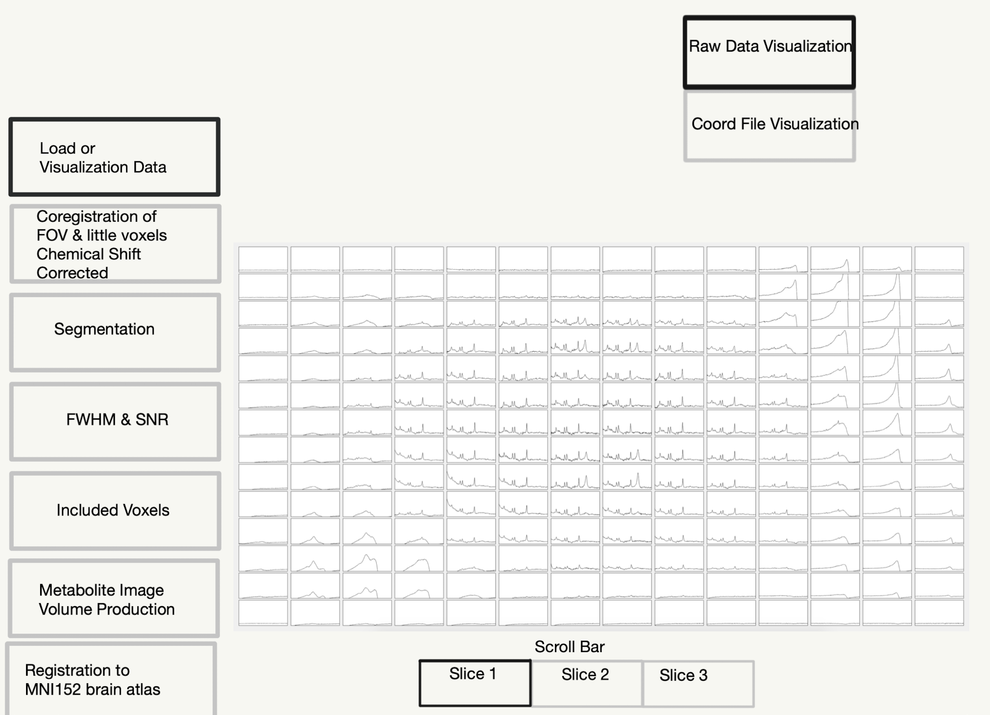

Slide 3
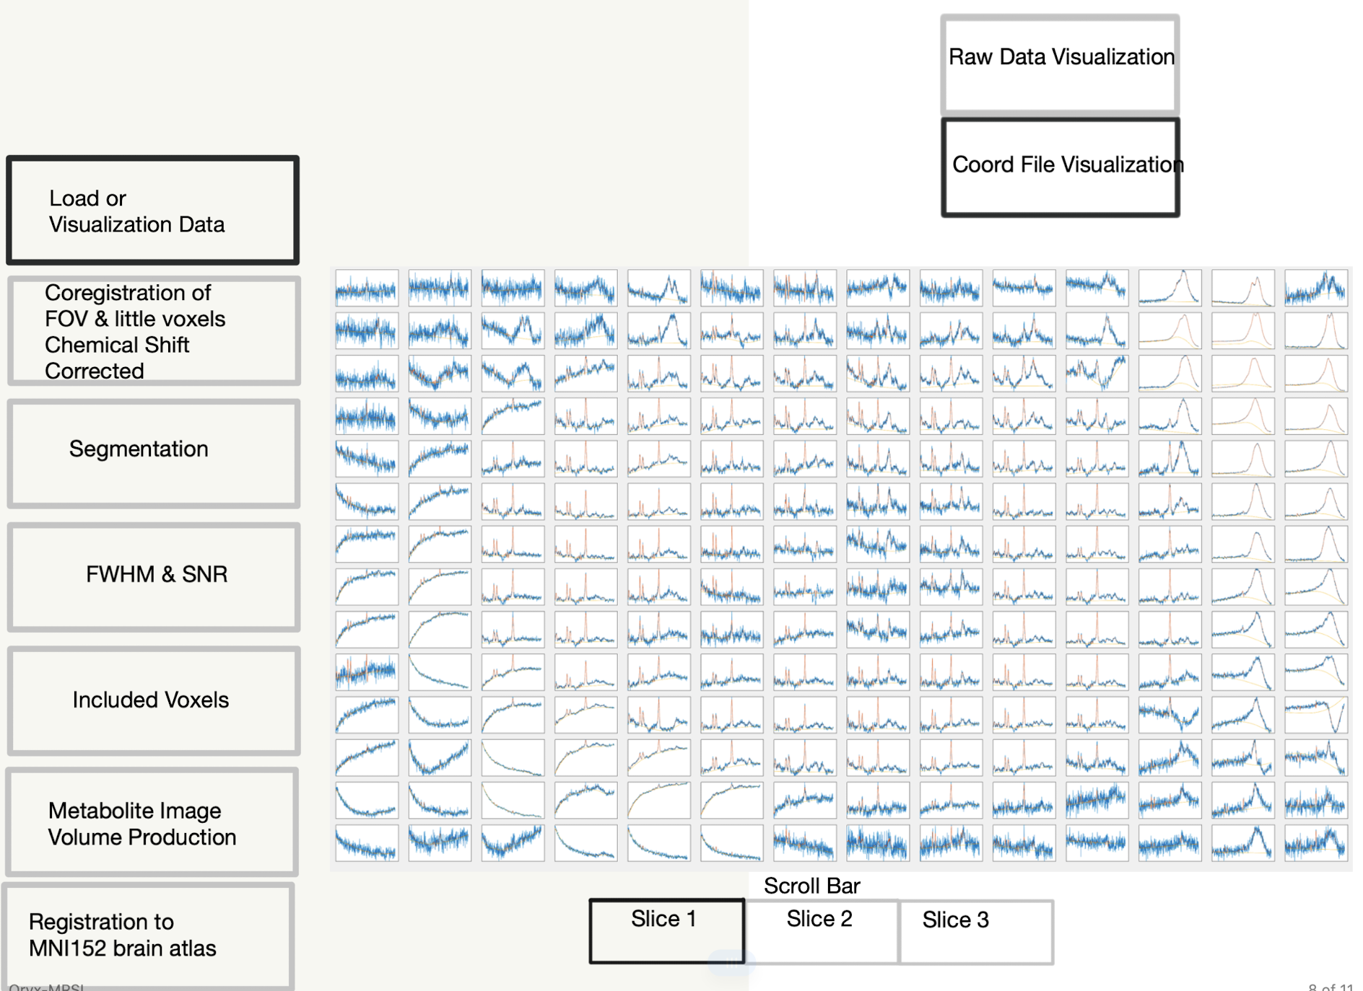

Slide 4
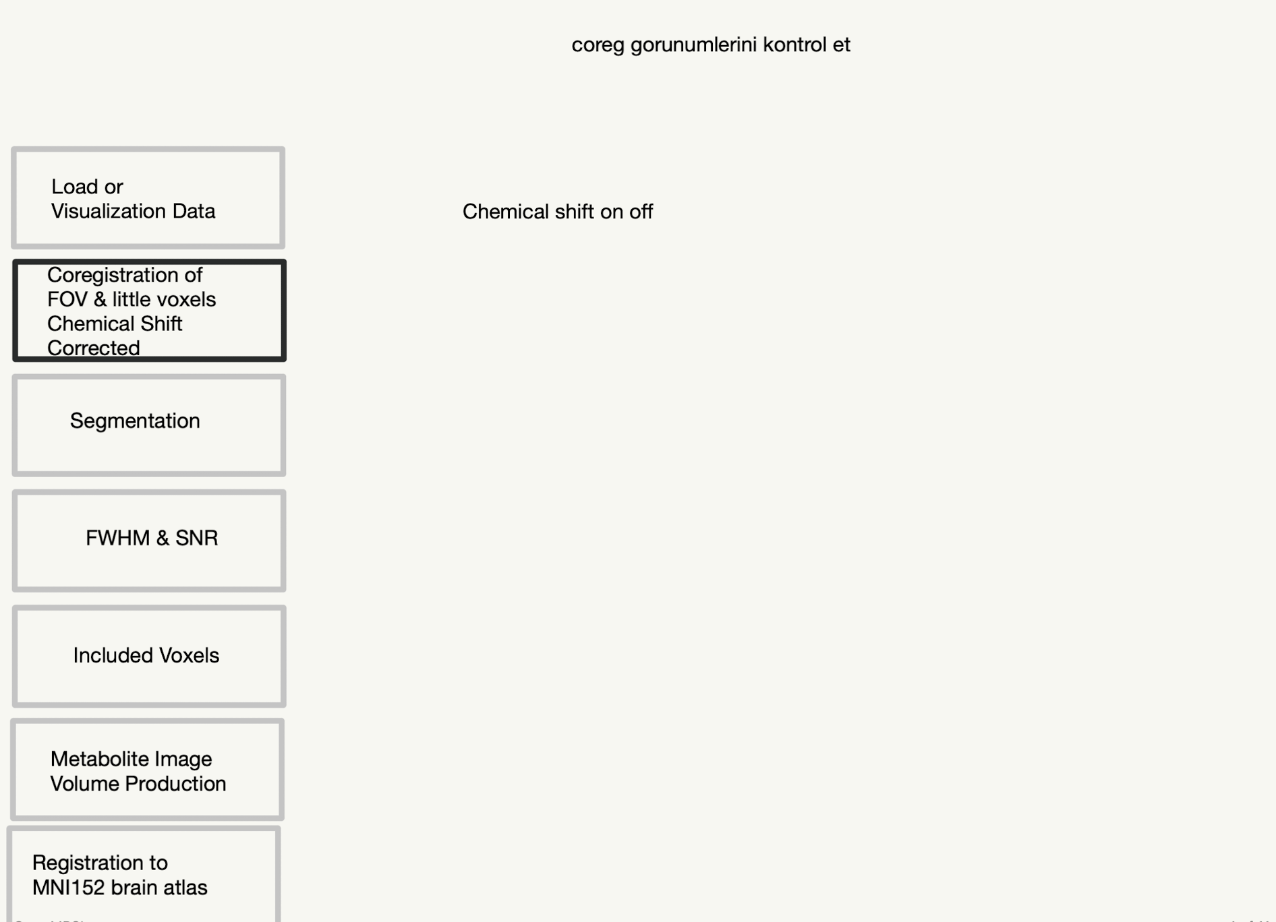
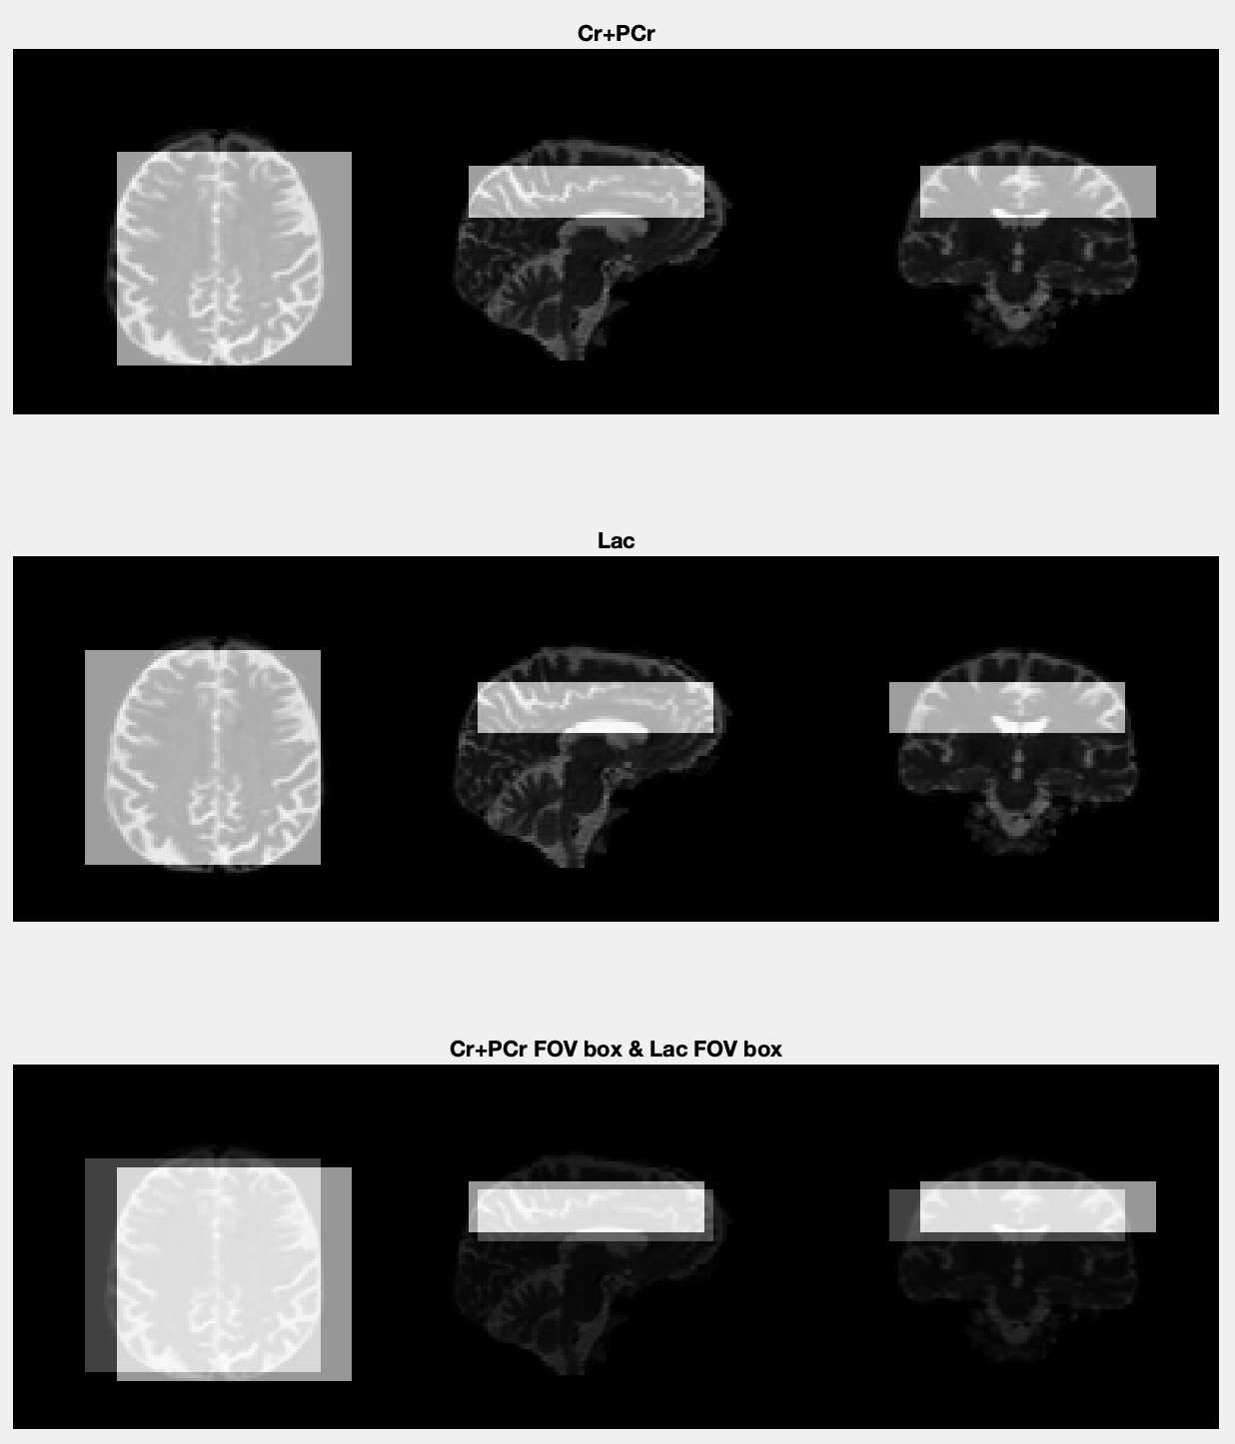

Slide 5
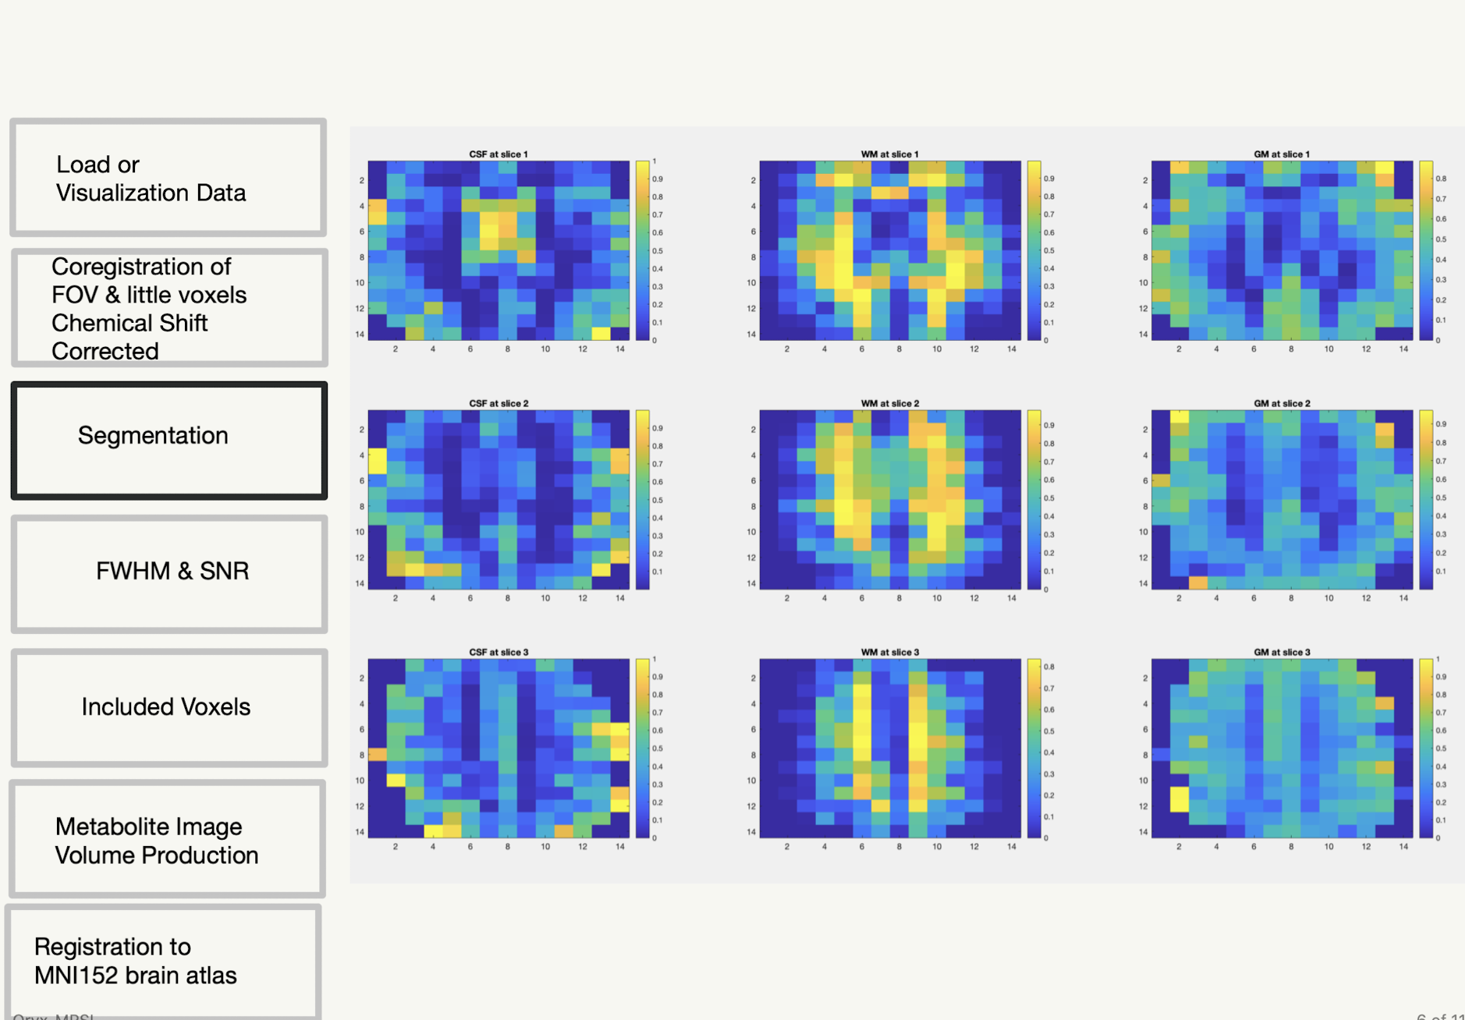

Slide 6
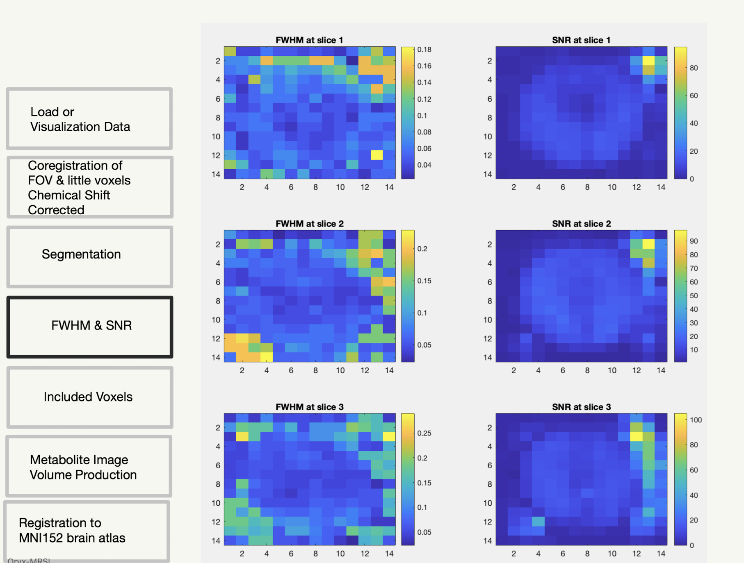

Slide 7
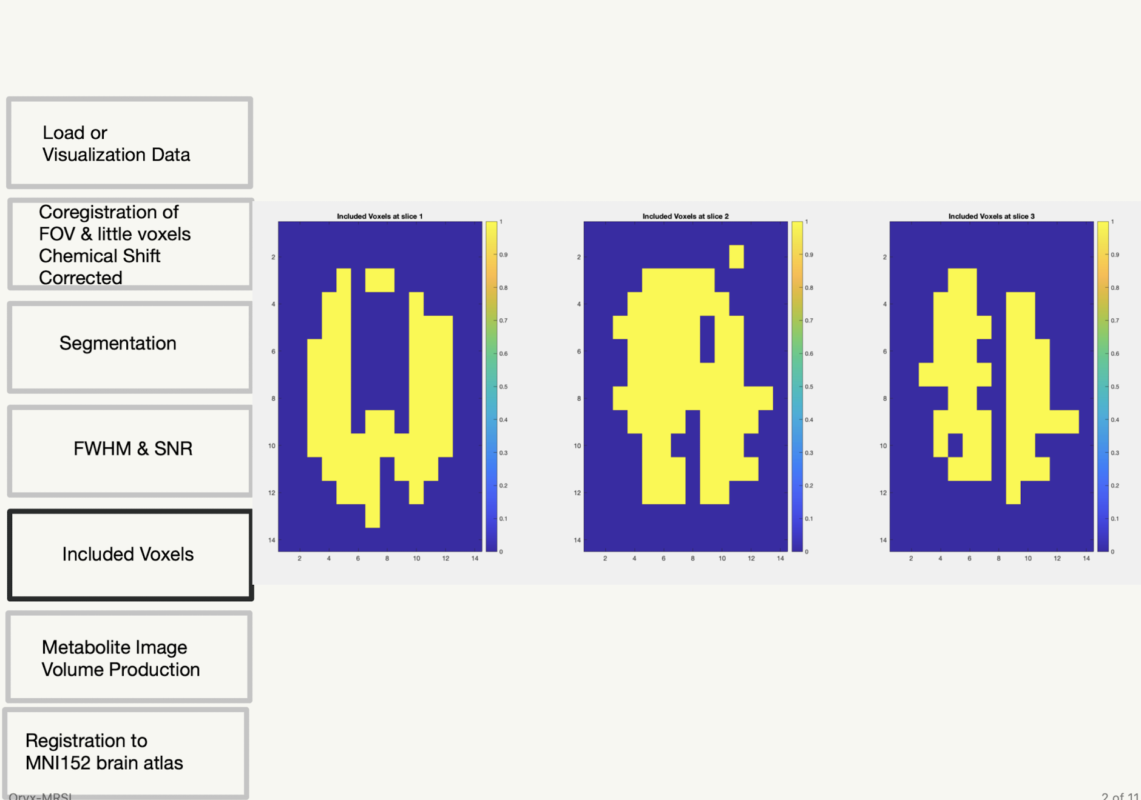

Slide 8
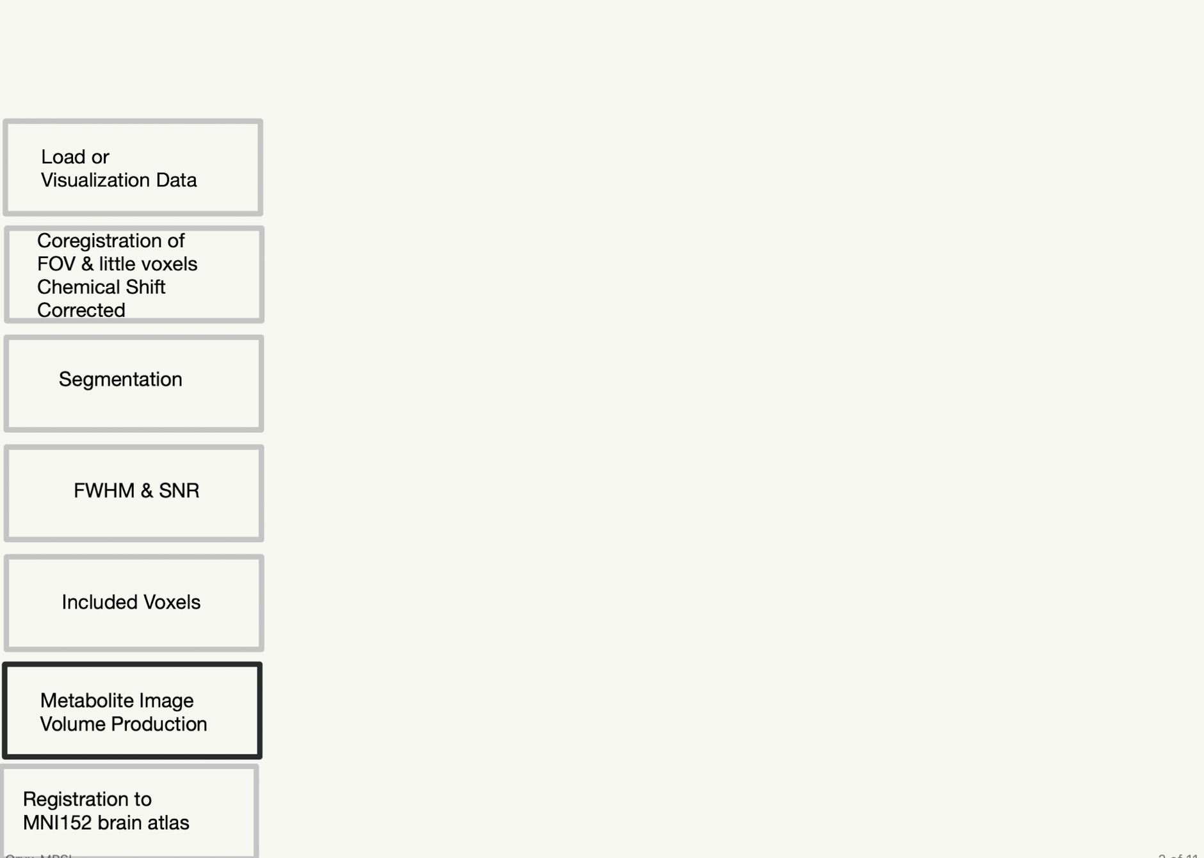
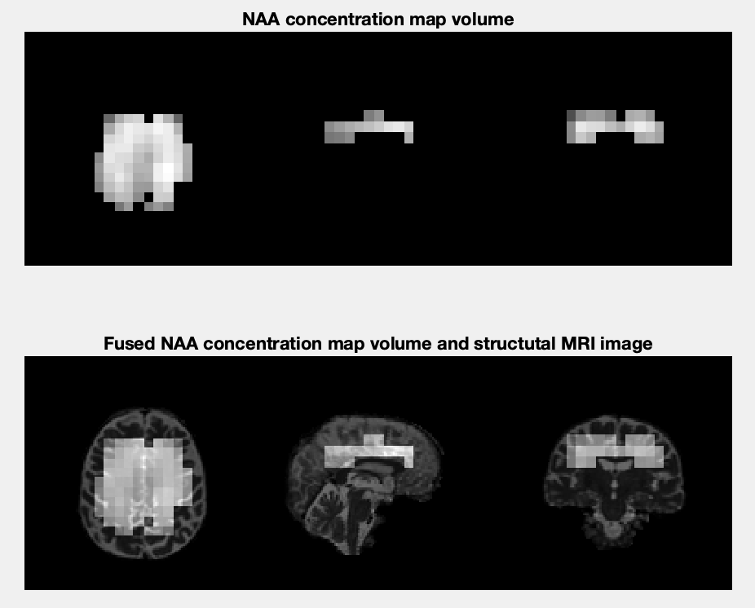

Slide 9
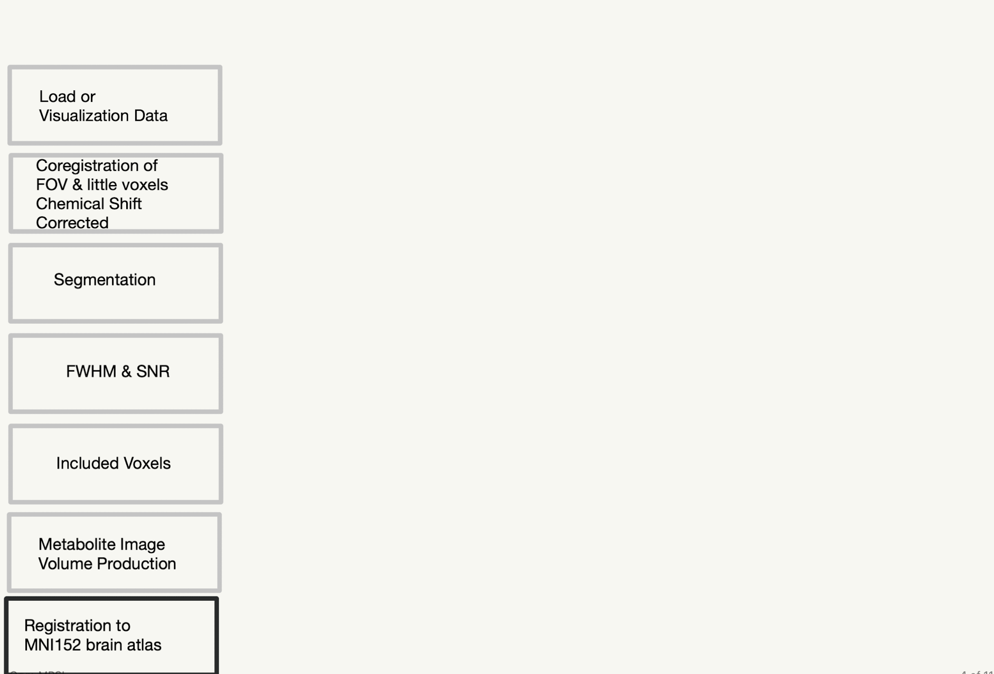
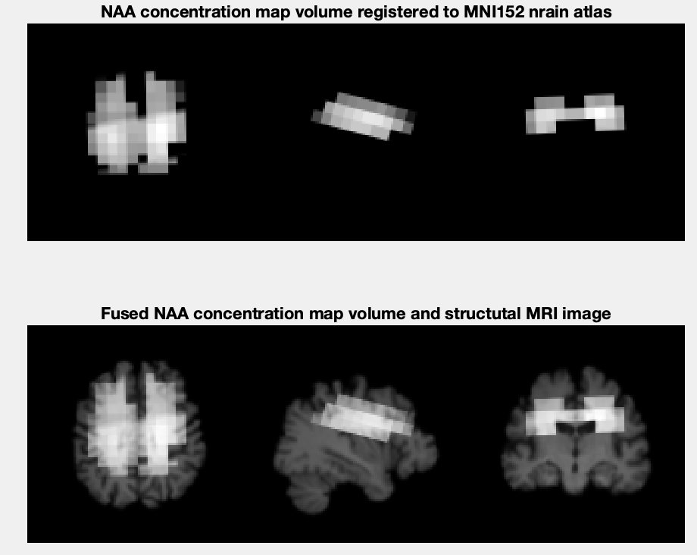

Slide 10
Analysis

